Slide 1


Insurance Analytics Project
Project : P972
By Group 6
Under Mentorship of :
Mr. Anand Babu
Mr. Silvan Wilson Fernandes

Slide 2









Meet Our Team
Christina
Boorsu Hemalatha
Bhuwan Sharma
Kurukunda Srinivas
Vijay Kumar
Rajat Mishra
Surya Shekhar Shukla
Varun Raj

Slide 3

Ahmedabad Weekly Review
Domain : Insurance Analytics
MODULES
Excel
MySql
Power BI
Tableau

Slide 4

Agenda
PROJECT INTRODUCTION
CLOSURE
1
8
PROJECT GOAL
2
MICROSOFT EXCEL
3
DATA DESCRIPTION
MAIN KPI ANALYSIS
MYSQL
4
DASHBOARD
5
POWER BI
PROJECT OUTCOME
6
7
CONCLUSION
TABLEAU

Slide 5

Project Introduction
This project is showcasing very important KPIs which the management can undergo in order to increase their policy sales. It also provides information about the work of the executives associated with the selling of the policies.
Tools Used :
For Data Cleaning - Power Query
For Visualisation - Excel, Power BI, Tableau
For Calculation - Pivot table in Excel, DAX in Power BI and Calculated Fields in Tableau
For writing queries - MySql
Use of Action Dashboard in Tableau
Use of Slicers to filter the data in real time
Use of Customize visuals in Power BI

Slide 6

Project Goal
To Clean the Data.
To create following KPIs which can provide impactful insights to the management :
No of Invoice by Accnt Exec
Yearly Meeting Count
Target, Achieve, New
Cross Sell-Target,Achive,new
New-Target,Achive,new
Renewal-Target, Achive,new
Stage Funnel by Revenue
No of meeting By Account Exe
Top Open Opportunity
Opportunity Product distribution
Creat interactive Dashboards with Slicers to filter the Dashboard.

Slide 7

Data Description
Brokerage - Contain information about clients' policies, including
policy details, income, and renewal status. It contains duplicate
records which must be removed.
Fees - Contains data on client-related income transactions,
including revenue details and transaction types.
Budget - Details the budget allocations for branches and
employees, including new roles, cross-sell initiatives, and renewals
Invoice - Holds information about invoices generated, including
transaction details and associated clients.
Meeting - Tracks meetings managed by account executives, including branch associations and attendee details.
Opportunity - Documents details of opportunities managed by account executives, including revenue, stages, and risk information.

Slide 8
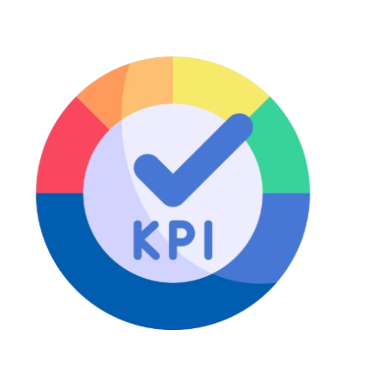
Main KPI Analysis
Targets vs. Achievements
Cross-Sell
New Business
Renewal
KPI Metrics
Cross-Sell Placement Achievement %
Cross-Sell Invoice Achievement %
New Invoice Achievement %
Renewal Placement Achievement %
Renewal Invoice Achievement %
Opportunity Management
Total Opportunities
Open Opportunities
Opportunity Distribution by Revenue
Yearly Meeting Count
No of Invoice by Accnt Exec
Top Revenue by Account Executive
Top Premium Amount by Product Group

Slide 9

Let’s see Excel Dashboard

Slide 10
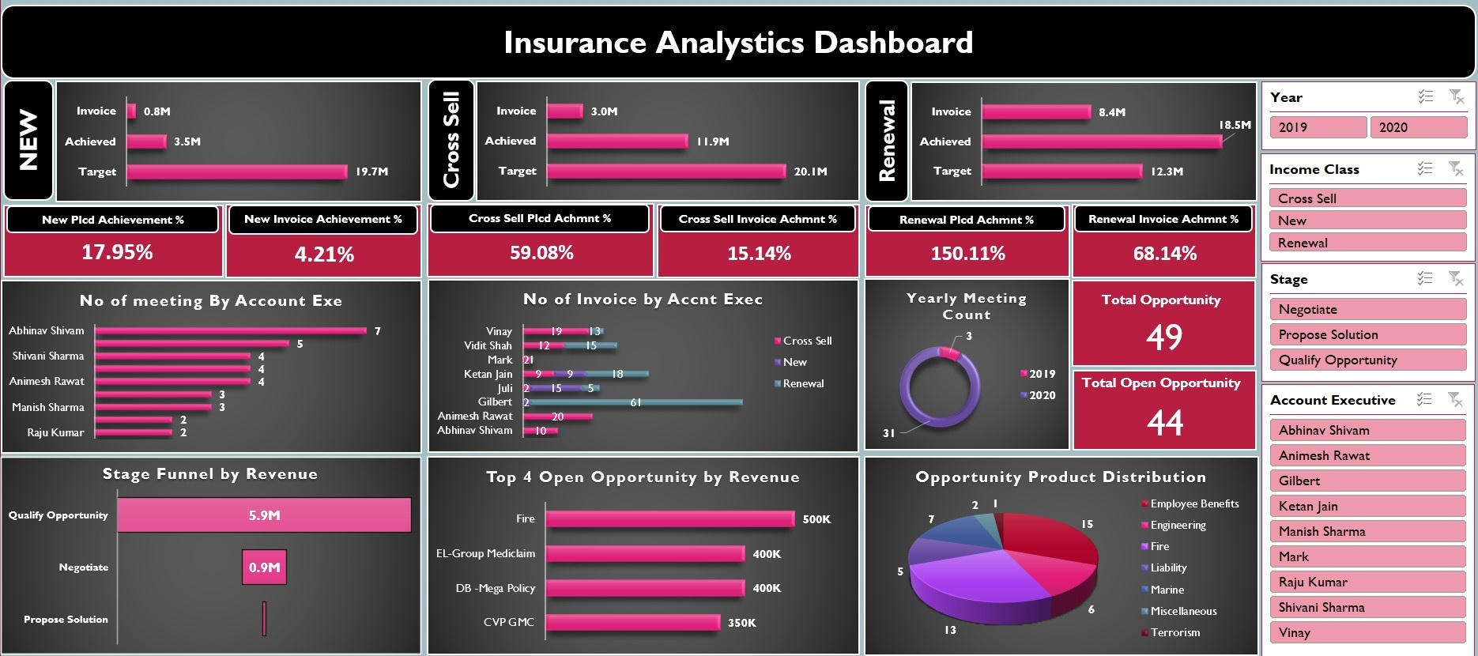
Excel Dashboard

Slide 11

Let’s see Queries in MySQL

Slide 12
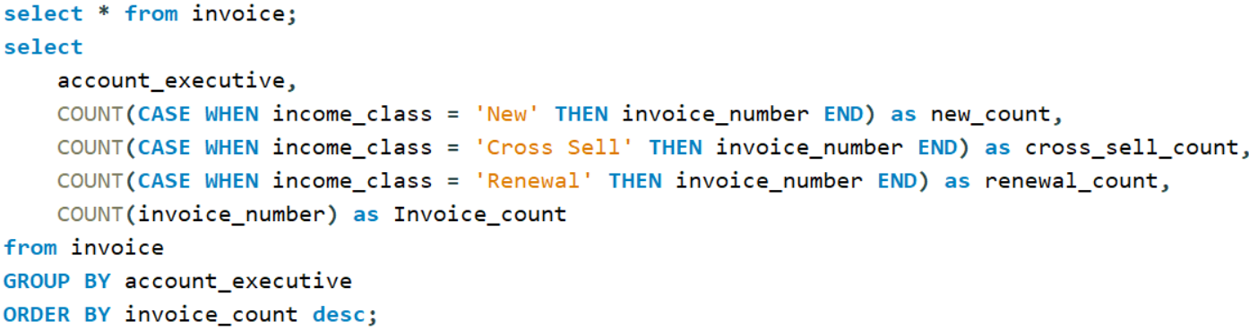
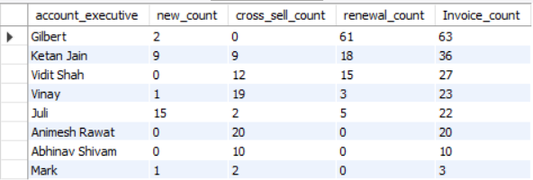
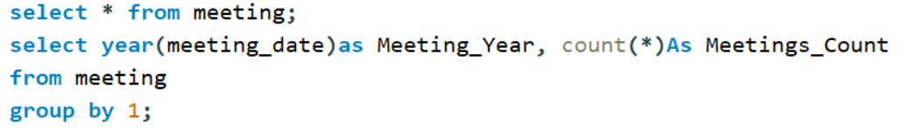
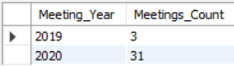
KPI 1 No of Invoice by Account Executive
Output :
KPI 2 Yearly Meeting Count
Output :

Slide 13
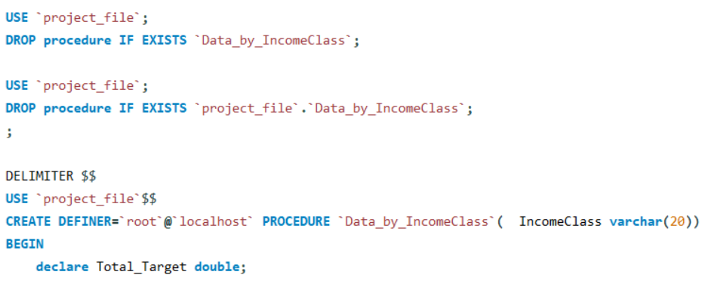
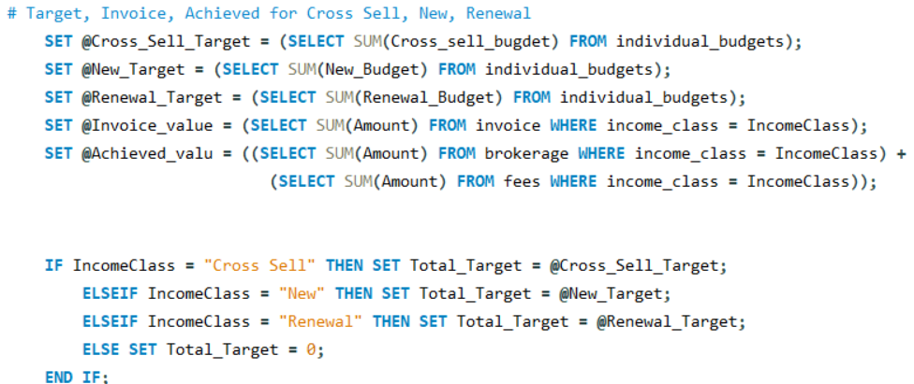
KPI 3 Placed Achievement % , Invoice Achievement % in Cross Sell, New, Renewal

Slide 14
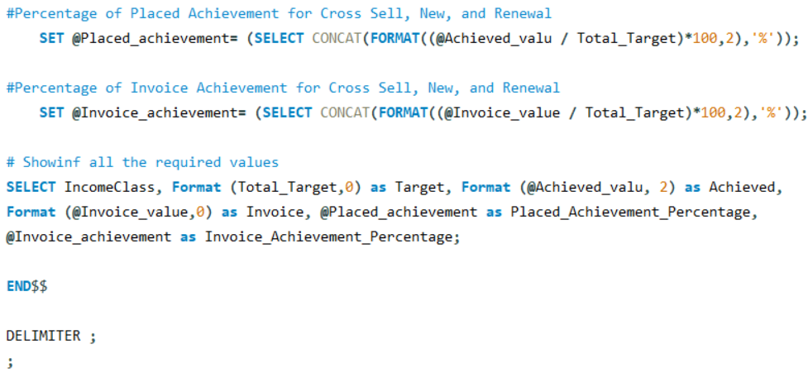
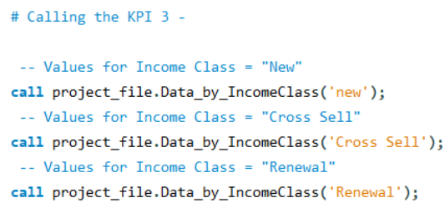

Slide 15
Output :

Slide 16
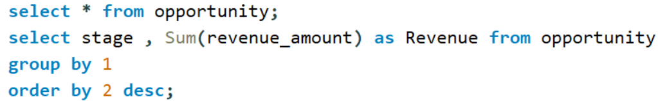
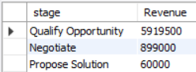
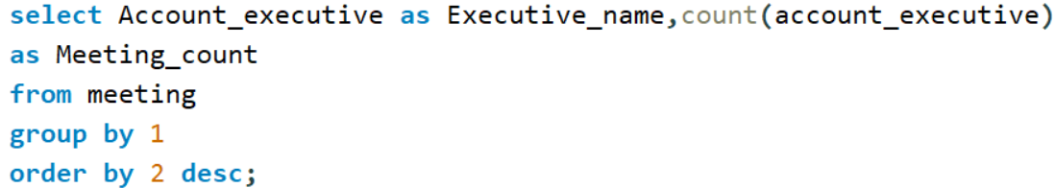
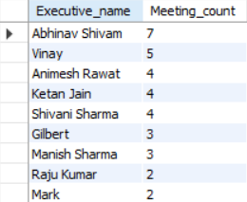
KPI 4 Stage Funnel by Revenue
Output :
KPI 5 No of meeting By Account Exe
Output :

Slide 17
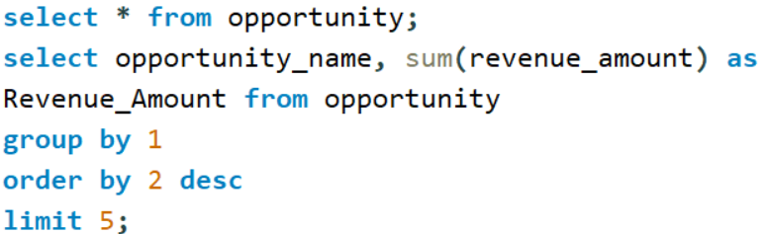
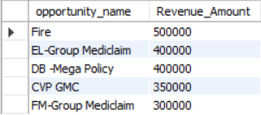
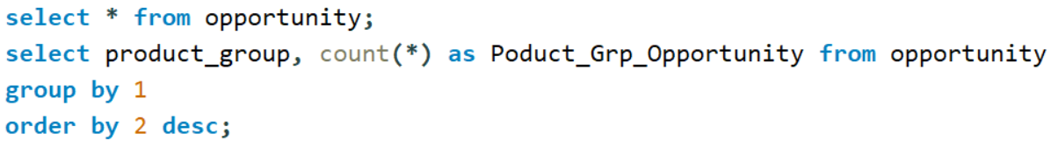
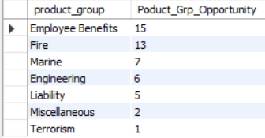
KPI 6 Top Open Opportunity
Output :
Opportunity Product Distribution
Output :

Slide 18

Let’s see Power BI Dashboard

Slide 19
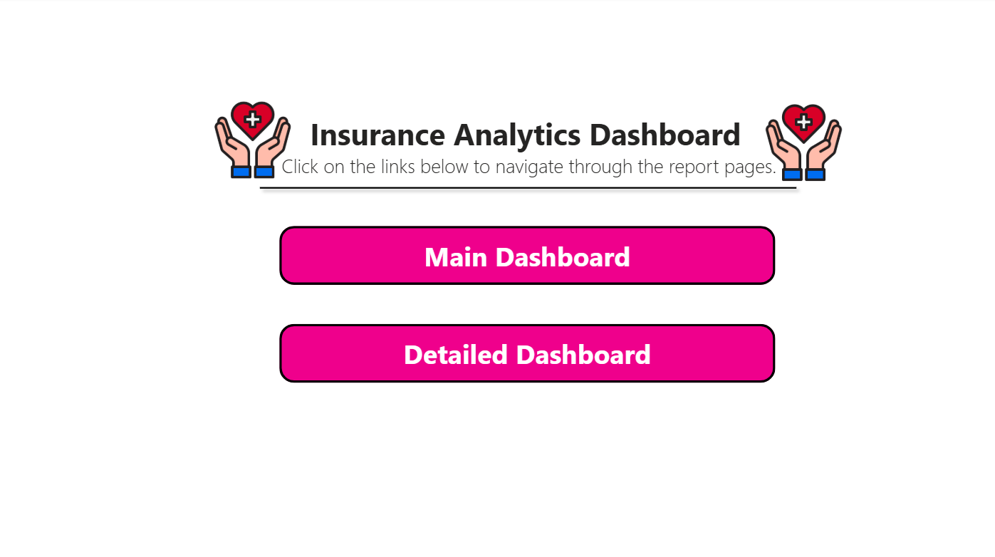
Index Page

Slide 20
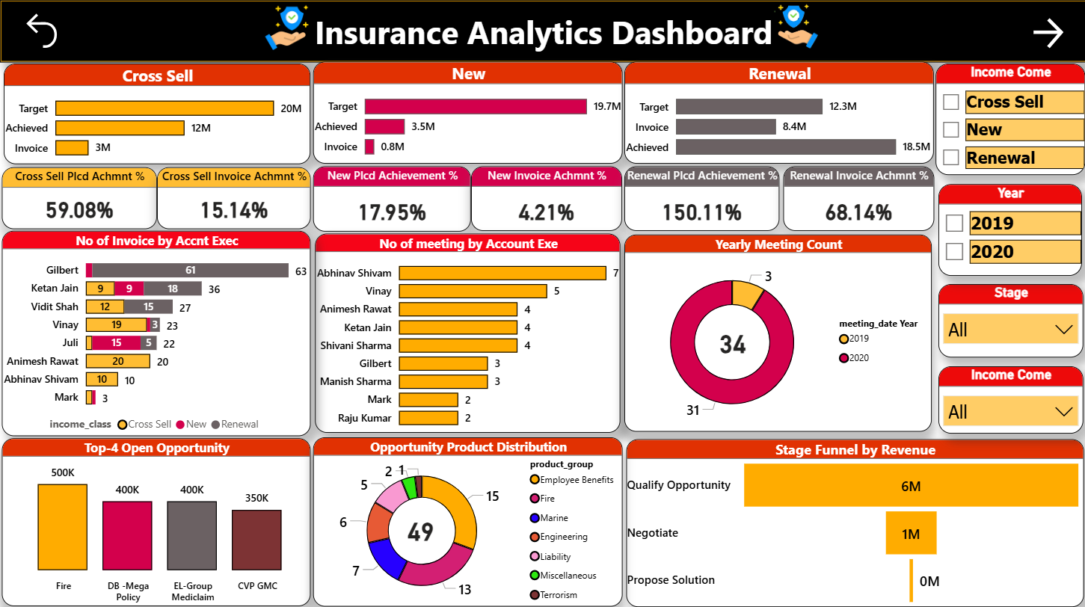

Slide 21
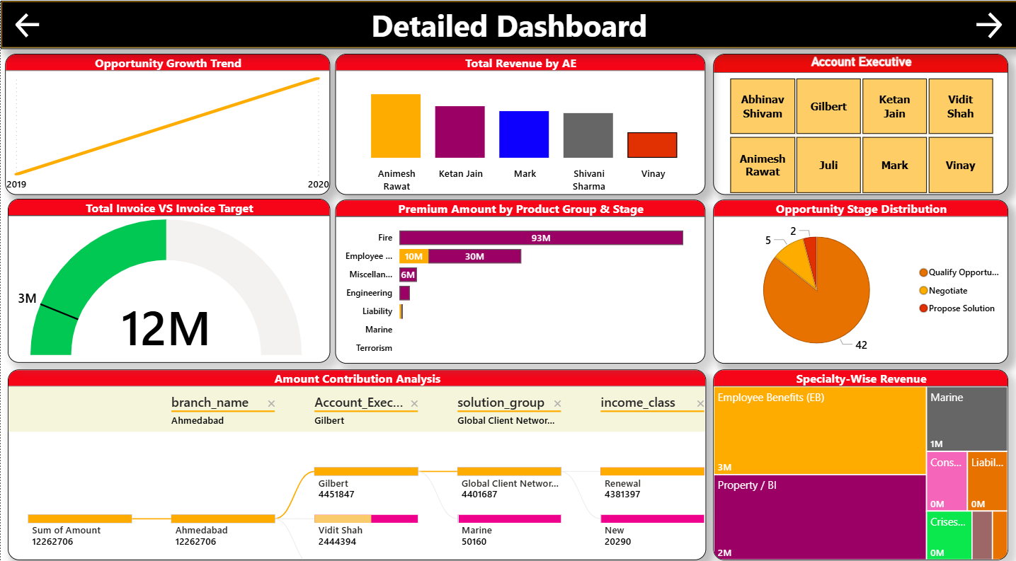

Slide 22

Let’s see Tableau Dashboard

Slide 23
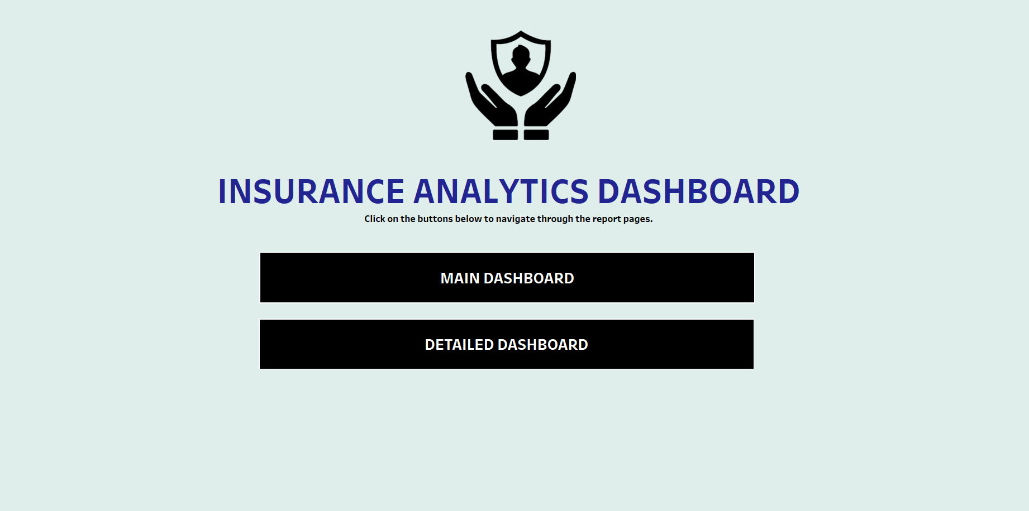
Index Page

Slide 24
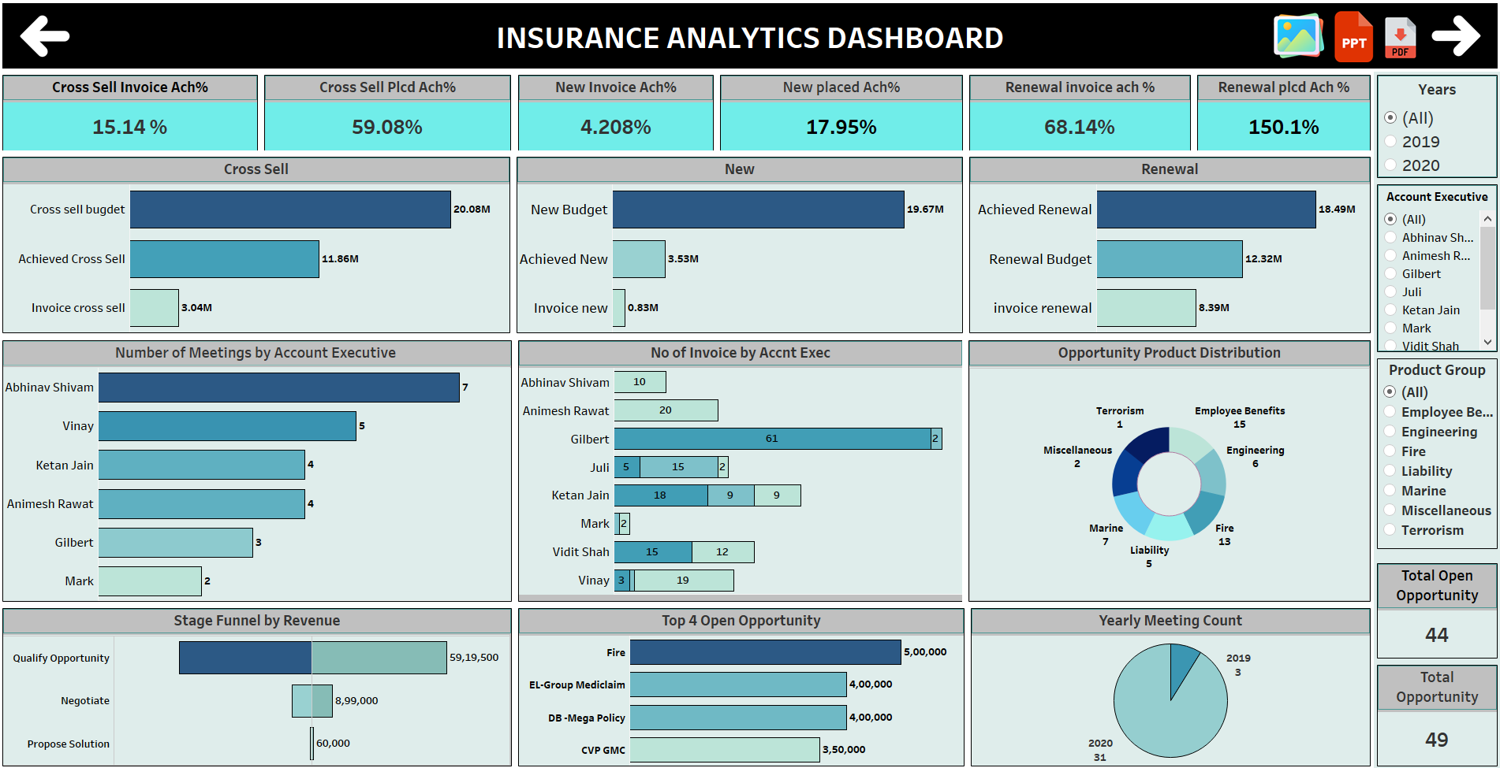

Slide 25
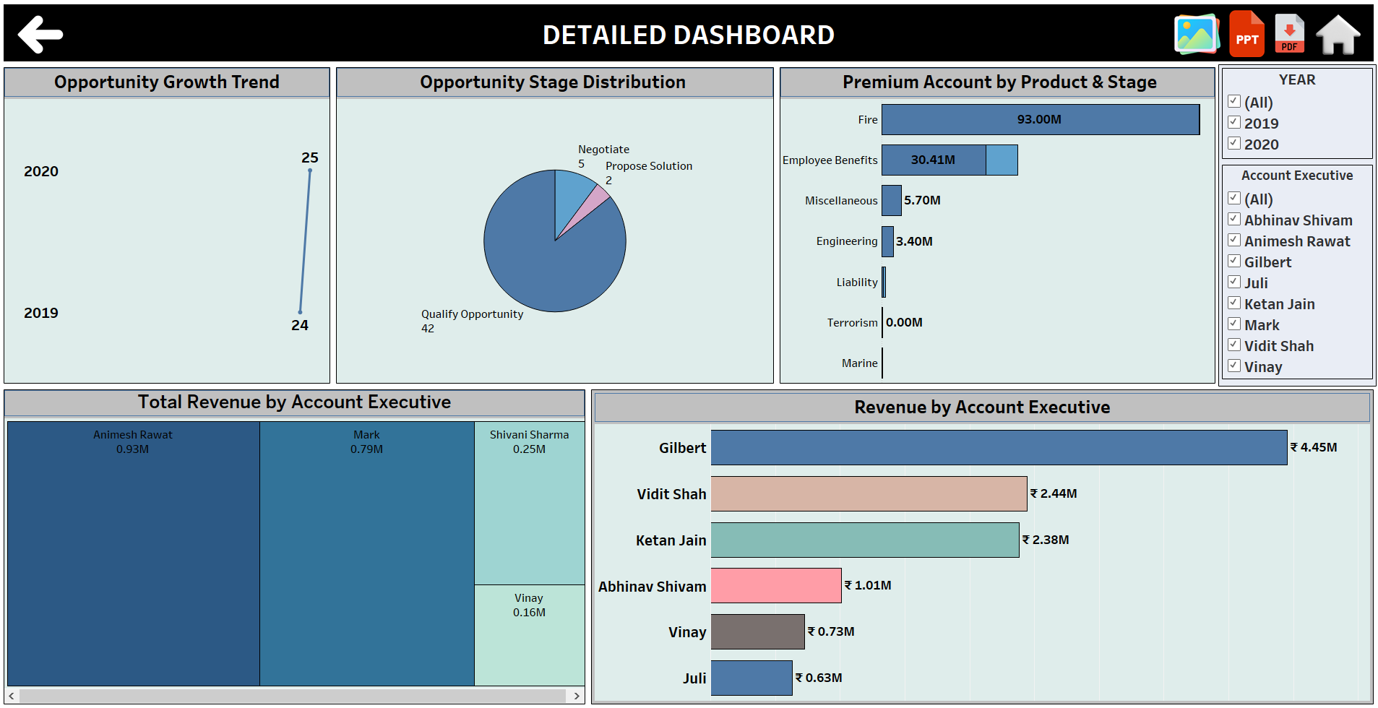

Slide 26

Project Outcome
Invoice & Performance :
Clear visibility into invoice trends by account executives.
Identified high-performing vs underperforming branches.
Revenue Drivers:
Segmentation into Cross-Sell, New, and Renewal opportunities.
Renewal policies contributed the largest share of profit.
Client Engagement:
Meeting analysis revealed strong link between engagement and revenue.
Helped track client activity to improve retention strategies.
Operational Efficiency:
Automated reporting reduced manual effort.
Faster turnaround time for generating business insights.
Customer Insights:
Segmented clients by policy type and renewal behavior.
Identified loyal customers vs at-risk customers.
Scalability & Future Use:
Dashboards designed for growing data volumes.
Framework ready for predictive analytics and forecasting.
Decision-Making Impact:
Enabled evidence-based decisions at leadership level.
Improved alignment between sales, operations, and marketing.
Compliance & Transparency:
Enhanced accuracy reduced compliance risks.
Built trust with stakeholders through transparent reporting

Slide 27

Project Conclusion
Strategic Decision-Making:
Data-driven insights support leadership decisions.
Enhanced visibility across revenue and profitability trends.
Client Retention & Growth:
Renewal policies show exceptional growth and profit margins.
Focus on sustaining renewal performance for long-term stability.
Sales Planning & Pipeline:
Visualization of opportunities supports accurate forecasting.
Clearer understanding of cross-sell and new policy potential.
Transparency & Accountability:
Dashboards ensure real-time performance tracking.
Improved accountability across teams through KPI monitoring.
Future-Readiness:
Establishes a base for predictive analytics (e.g., forecasting renewals).
Aligns business goals with measurable KPIs for continuous improvement.

Slide 28

Thank
you

